Slide 1
Facilitating Dialogue
With C.R. “Chuck” Dunning, Jr.

Slide 2
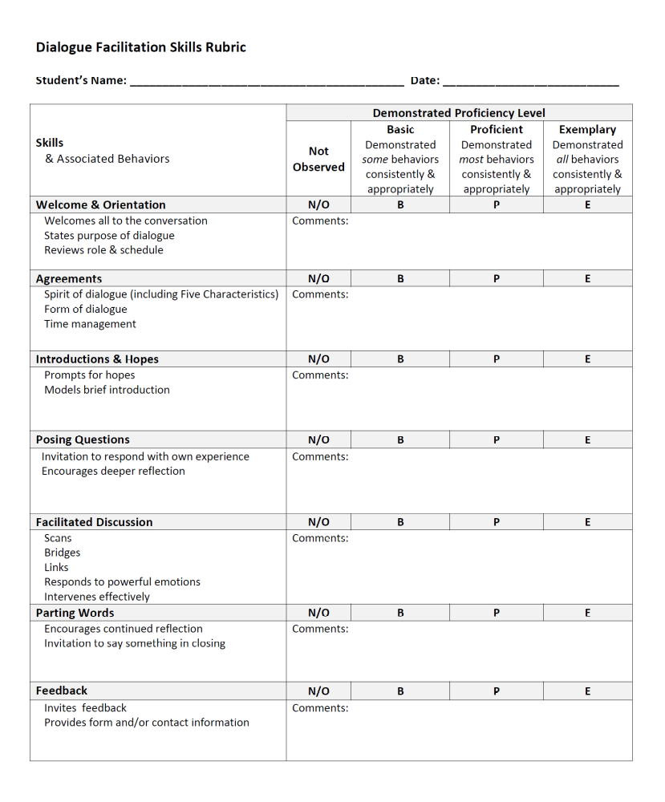

Slide 3
Purpose of Dialogue
Characteristics of Dialogue
Your Role as Facilitator
Welcome & Orientation
Agreements
Participant Introductions
Opening Discussion
Facilitation Skills
Wrapping Up
Getting Feedback

Slide 4
Know the Purpose of Dialogue

Slide 5
Know the Purpose of Dialogue
Sharing thoughts and feelings

Slide 6
Know the Purpose of Dialogue
Sharing thoughts and feelings
Exploring possibilities

Slide 7
Know the Purpose of Dialogue
Sharing thoughts and feelings
Exploring possibilities
Not about problem-solving, “answers,” or agreement, although those things might happen for some members

Slide 8
Know the Purpose of Dialogue
Sharing thoughts and feelings
Exploring possibilities
Not about problem-solving, “answers,” or agreement, although those things might happen for some members
Additional Benefits

Slide 9
Know the Purpose of Dialogue
Sharing thoughts and feelings
Exploring possibilities
Not about problem-solving, “answers,” or agreement, although those things might happen for some members
Additional Benefits
  Belonging

Slide 10
Know the Purpose of Dialogue
Sharing thoughts and feelings
Exploring possibilities
Not about problem-solving, “answers,” or agreement, although those things might happen for some members
Additional Benefits
  Belonging
  Trust

Slide 11
Know the Purpose of Dialogue
Sharing thoughts and feelings
Exploring possibilities
Not about problem-solving, “answers,” or agreement, although those things might happen for some members
Additional Benefits
  Belonging
  Trust
  Normalization

Slide 12
Characteristics of Dialogue

Slide 13
Characteristics of Dialogue
Humility

Slide 14
Characteristics of Dialogue
Humility “I know that people who are wiser and more informed than me on this topic can disagree with each other.”

Slide 15
Characteristics of Dialogue
Humility “I know that people who are wiser and more informed than me on this topic can disagree with each other.”
Hope

Slide 16
Characteristics of Dialogue
Humility “I know that people who are wiser and more informed than me on this topic can disagree with each other.”
Hope “I believe good things can come from this dialogue.”

Slide 17
Characteristics of Dialogue
Humility “I know that people who are wiser and more informed than me on this topic can disagree with each other.”
Hope “I believe good things can come from this dialogue.”
Faith

Slide 18
Characteristics of Dialogue
Humility “I know that people who are wiser and more informed than me on this topic can disagree with each other.”
Hope “I believe good things can come from this dialogue.”
Faith “I have sufficient trust in the other participants’ good intentions.”

Slide 19
Characteristics of Dialogue
Humility “I know that people who are wiser and more informed than me on this topic can disagree with each other.”
Hope “I believe good things can come from this dialogue.”
Faith “I have sufficient trust in the other participants’ good intentions.”
Love

Slide 20
Characteristics of Dialogue
Humility “I know that people who are wiser and more informed than me on this topic can disagree with each other.”
Hope “I believe good things can come from this dialogue.”
Faith “I have sufficient trust in the other participants’ good intentions.”
Love “I care about and respect others as whole human beings.”

Slide 21
Characteristics of Dialogue
Humility “I know that people who are wiser and more informed than me on this topic can disagree with each other.”
Hope “I believe good things can come from this dialogue.”
Faith “I have sufficient trust in the other participants’ good intentions.”
Love “I care about and respect others as whole human beings.”
Critical Thinking

Slide 22
Characteristics of Dialogue
Humility “I know that people who are wiser and more informed than me on this topic can disagree with each other.”
Hope “I believe good things can come from this dialogue.”
Faith “I have sufficient trust in the other participants’ good intentions.”
Love “I care about and respect others as whole human beings.”
Critical Thinking “I will carefully consider all perspectives, including my own.”

Slide 23
Stick to Your Role

Slide 24
Stick to Your Role
Stimulate the process

Slide 25
Stick to Your Role
Stimulate the process
Active Listening

Slide 26
Stick to Your Role
Stimulate the process
Active Listening
Encourage sharing

Slide 27
Stick to Your Role
Stimulate the process
Active Listening
Encourage sharing
Engage as many as possible

Slide 28
Stick to Your Role
Stimulate the process
Active Listening
Encourage sharing
Engage as many as possible
Redirect as necessary

Slide 29
Stick to Your Role
Stimulate the process
Active Listening
Encourage sharing
Engage as many as possible
Redirect as necessary
Practice restraint with your opinions and knowledge

Slide 30
Welcome & Orientation

Slide 31
Welcome & Orientation
Facilitator introductions, including hopes and intentions

Slide 32
Welcome & Orientation
Facilitator introductions, including hopes and intentions
Reminder of Masonic ideals for how we meet, act, and part

Slide 33
Welcome & Orientation
Facilitator introductions, including hopes and intentions
Reminder of Masonic ideals for how we meet, act, and part
Assurance of non-judgmental openness to honest, respectful sharing

Slide 34
Welcome & Orientation
Facilitator introductions, including hopes and intentions
Reminder of Masonic ideals for how we meet, act, and part
Assurance of non-judgmental openness to honest, respectful sharing
Speaking is always voluntary

Slide 35
Agreements

Slide 36
Agreements
Mutual understanding of form (one person speaks at a time)

Slide 37
Agreements
Mutual understanding of form (one person speaks at a time)
Request shared awareness of time

Slide 38
Agreements
Mutual understanding of form (one person speaks at a time)
Request shared awareness of time
Establish commitment to mutual respect and confidentiality

Slide 39
Participant Introductions

Slide 40
Participant Introductions
Names and other basic info

Slide 41
Participant Introductions
Names and other basic info
Hopes and intentions

Slide 42
Opening Discussion

Slide 43
Opening Discussion
State the topic

Slide 44
Opening Discussion
State the topic
Prepared initial questions

Slide 45
Facilitated Discussion

Slide 46
Facilitated Discussion
Active Listening

Slide 47
Facilitated Discussion
Active Listening
Encouraging

Slide 48
Facilitated Discussion
Active Listening
Encouraging
Scanning

Slide 49
Facilitated Discussion
Active Listening
Encouraging
Scanning
Bridging

Slide 50
Facilitated Discussion
Active Listening
Encouraging
Scanning
Bridging
Linking

Slide 51
Facilitated Discussion
Active Listening
Encouraging
Scanning
Bridging
Linking
Responding to powerful emotions

Slide 52
Facilitated Discussion
Active Listening
Encouraging
Scanning
Bridging
Linking
Responding to powerful emotions
Intervening effectively

Slide 53
Wrapping Up (Parting Words)

Slide 54
Wrapping Up (Parting Words)
Encourage continued reflection

Slide 55
Wrapping Up (Parting Words)
Encourage continued reflection
Restate common themes, repeated points, poignant moments

Slide 56
Wrapping Up (Parting Words)
Encourage continued reflection
Restate common themes, repeated points, poignant moments
Invitation to say something in closing

Slide 57
Wrapping Up (Parting Words)
Encourage continued reflection
Restate common themes, repeated points, poignant moments
Invitation to say something in closing
Reminder about future events

Slide 58
Feedback (Debrief)

Slide 59
Feedback (Debrief)
Invite feedback

Slide 60
Feedback (Debrief)
Invite feedback
  What went well?

Slide 61
Feedback (Debrief)
Invite feedback
  What went well?
  What was most helpful?

Slide 62
Feedback (Debrief)
Invite feedback
  What went well?
  What was most helpful?
  What was challenging?

Slide 63
Feedback (Debrief)
Invite feedback
  What went well?
  What was most helpful?
  What was challenging?
  What could have been done differently?

Slide 64
Feedback (Debrief)
Invite feedback
  What went well?
  What was most helpful?
  What was challenging?
  What could have been done differently?
Provide form and/or contact information

